Slide 1
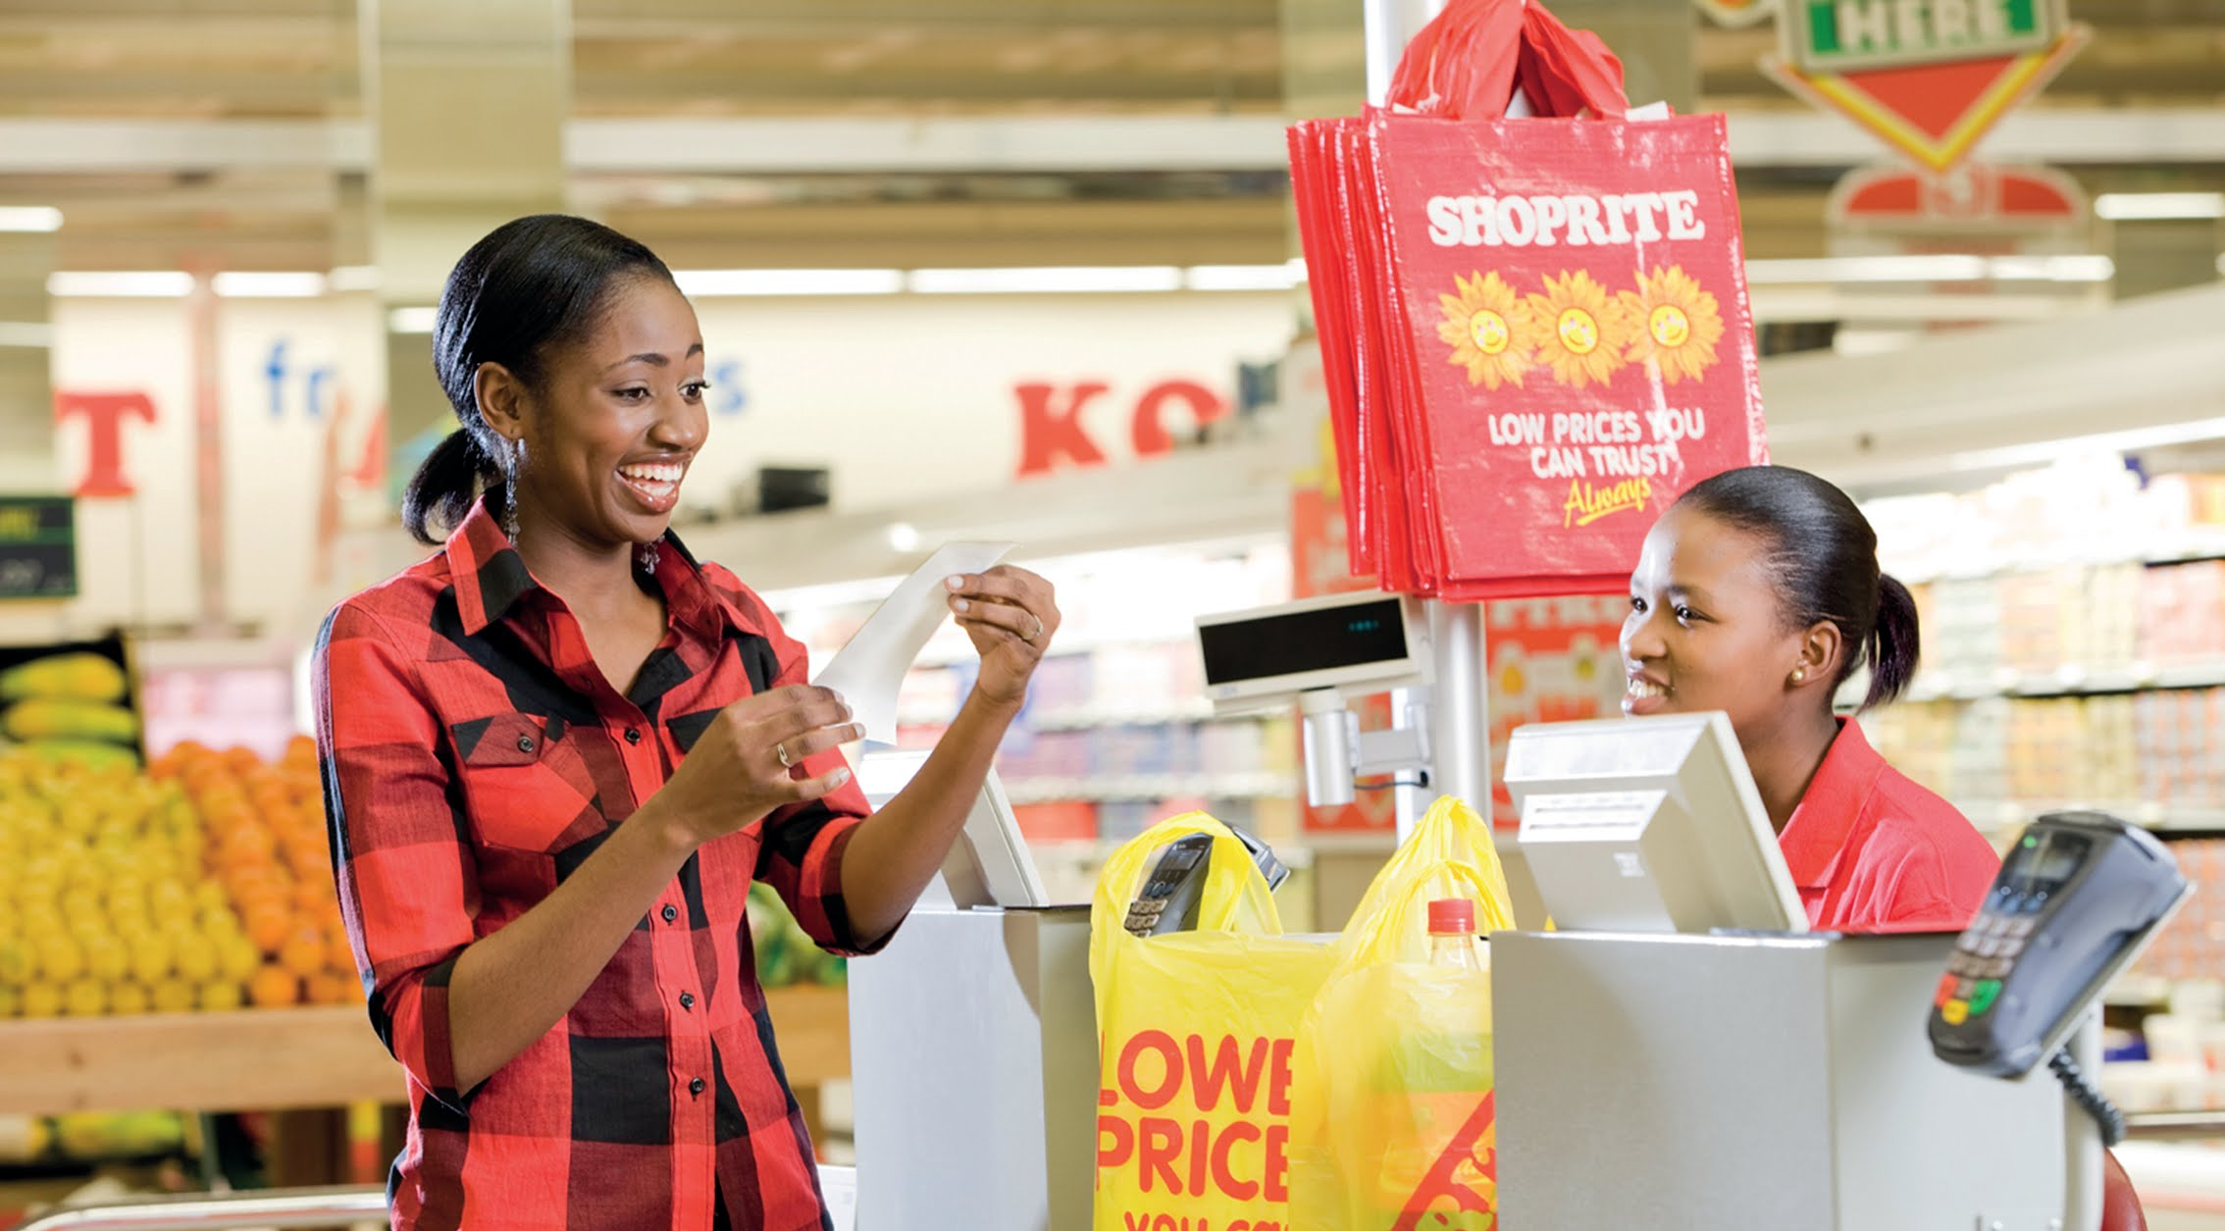
Project Approval Committee (PAC)
7 April 2021
Document has been replaced. The master can now be found here:
https://drive.google.com/drive/u/0/folders/1wh9D-f3-X-v-ncX2vqnJxGxRGuMoMWuH
Project Concept Approval
5665-Enterprise eCommerce Platform
Sponsor: Pieter Engelbrecht
Business Owner: Mark Cotton

Slide 2
Description of the Project
Describe the Project / what we want to do
Implement an accelerated e-commerce platform to enable multiple business units to offer a comprehensive B2B & B2C shopping experience. The solution will leverage existing technology components in the Xtra Savings stack and integrations to speed up implementation. SAP Commerce standard technology will be utilised to enable a rapid go to market, including Basket/Checkout and UI for the initial go-live.
The approach will be to deliver a standardised e-commerce capability & UI for all BU’s in an initial accelerated implementation. Thereafter the project will focus on enhancing and differentiating individual BU e-commerce solutions based on their specific requirements. The replacement of some services (for example Basket/Checkout), with technologies that are more aligned with Shoprite’s end-state reference architecture, will also be considered.
Justify why we want to do this project
Shoprite executive has directed that future e-commerce platforms must conform to an enterprise reference architecture which maximises re-usability, shares platform costs and that delivers a consistent customer experience.
Executive level interactions with individual business units have identified immediate opportunities to enhance revenues and reduce costs by introducing, extending or enhancing current e-commerce offerings. This includes Pharmacy, Food Services, Furniture, Franchise, Liquor & Financial Services. This project will :
Enable these business units to achieve their e-commerce aspirations in an accelerated time frame.
Establish core components of the future enterprise e-commerce architecture in flexible way, that allows for services to be swapped out in future if better or more cost-effective solutions are identified.
Synergise with existing on-demand e-commerce initiatives (Sixty60, 365) to ensure maximum leverage of shared components, and convergence where appropriate, without delaying the roll-out of new e-commerce value propositions.
Deliver the first steps of the journey towards establishing the Shoprite.Africa platform.
Notes:
The solution will leverage existing technology components in the Xtra Savings stack (including Product Catalog & Search) as well as integrations (for example to CIAM, CLPE and Payment Gateway) to speed up implementation.

Slide 3
Costs and Benefits
Estimated 5 Year Total Cost of Ownership Category (Indicate with ✔️)
R1 mil to R10 mil | R10 mil to R50 mil | R50 mil to R100 mil | R 100+ mil
✔️
Return on Investment Expected? | ✔️or ❌
If ROI = ✔️, provide Indicative Tangible Benefits below
Operational Cost Saving (pa) | R14,834,388.96
Capital Cost Saving | R 0
Revenue Increase (pa) | Revenue increase will be realised by each business unit utilising the platform built
If ROI =❌, provide Details below
Audit Finding
Legislation (specify)
Other (Why we need to do it?)
Amount Required for Investigation (Indicate with ✔️) |  | Investigation Approved ✔️or ❌?
Under R500k | 500k to R1 mil | R1 mil to R1.5 mil | R 1.5+ mil
✔️

